Slide 1
Recurrent Neural Networks For NLP

Slide 2
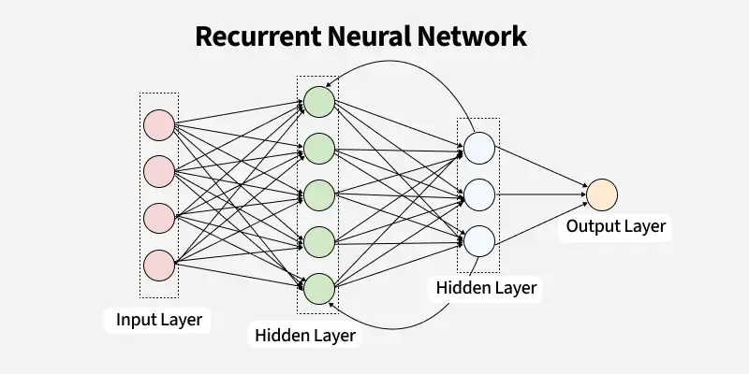
What are Recurrent Neural Networks?
Definition : An RNN (Recurrent Neural Network) is a type of artificial neural network designed to recognize patterns in sequences of data, such as time series, text, speech, or video.
Key Points :
RNNs process data one step at a time while maintaining memory of past inputs.
The hidden state is updated at each time step based on the current input and the previous hidden state.
They are widely used in tasks like natural language processing (NLP), speech recognition, machine translation, and time series forecasting.
Example :
If you’re predicting the next word in a sentence, an RNN can use previously seen words to make a better prediction.
Structure :

Slide 3
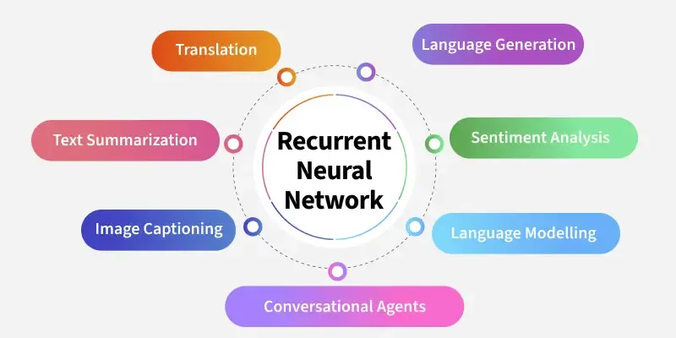
Uses :
1.Translation.
2.Iamge captioning.
3.Text Summarization.
Formulas :
1.Hidden State Update :
ht​=tanh(Wxh​⋅xt​+Whh​⋅ht−1​+bh​)
where,
hth_tht​ → new hidden state at time ttt
xtx_txt​ → input at time ttt
Wxh,WhhW_{xh}, W_{hh}Wxh​,Whh​ → weight matrices
bhb_hbh​ → bias
tanh⁡\tanhtanh → activation function.

Slide 4
2.Output Calculation :
yt​=softmax(Why​⋅ht​+by​)
yt → output at time t.
Why​ → output weight matrix.
byb_yby​ → bias.
Workflow with Simple Example :
For a Sentence like “I love AI”:
At t=1,input = “I” → RNN produces hidden state h1.
At t =2, input =“love ” +memory h1 →produces h2.
At t =3,input = “AI” + memory h2 →produces h3 and final prediction.
So the Network keeps passing the hidden State forward in time.
Types of RNN :
1.One-to-One RNN :- Single Input → Single Output.
2.One-to-Many RNN :- Single Input → Multiple Outputs.
3.Many-to-One RNN :- Multiple Inputs → Single Output.
4.Many-to-Many RNN :- Multiple Inputs → Multiple Outputs.

Slide 5
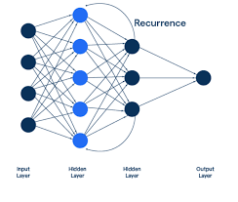
Recurrence in RNN :
Recurrence in RNNs is the mechanism that allows the network to maintain a "memory" of previous inputs by repeatedly applying the same set of weights to sequential data. This recurrence enables the network to capture temporal dependencies across different steps in a sequence.
Some Examples:
1.Language / Text Prediction :
Suppose you’re typing : “ I went to the coffee ___”The RNN needs to predict the next word.
To do this, it must remember the previous words ("I", "went", "to", "the") to suggest “shop” or “house”.
Recurrence helps the model keep track of past words so the prediction makes sense in context.
2. Music Listening / Playlist Generation :
Imagine Spotify is recommending the next song.
If you just listened to calm piano tracks, the system remembers this sequence and recommends another similar track.
Without recurrence (memory of past songs), it might randomly suggest heavy metal, which wouldn’t match your mood.
3. Weather Forecasting :
To predict tomorrow’s weather, you don’t just look at today — you also need to remember the past few days of temperature, humidity, and pressure.
RNN recurrence works like this: it keeps track of historical data step by step to forecast future values.

Slide 6
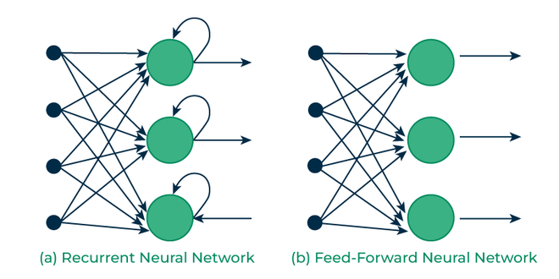
Difference Between RNN and Feedforward neural networks :
1.Feed-Forward Neural Networks :
Feed-Forward neural network is a type of neural network where the connections between nodes do not form cycles. It processes input data in one direction i.e from input to output, without any feedback loops.
No memory of previous inputs.
Best suited for static data (e.g., images).
Simple and fast to train.
Cannot handle sequences or time dependencies.
2.Recurrent Neural Networks :
Recurrent Neural Network add a missing element from feed-forward networks i.e memory. They can remember information from previous steps, making them ideal for sequential data where context matters.
Has memory of previous inputs using hidden states.
Ideal for sequential data like text, speech, time series.
Can suffer from vanishing gradient problems.
More complex and slower to train.
Difference in Architecture :

Slide 7
Using Some Real Life Examples :
1.Image Classification :
Task: “Is this an image of a cat or a dog?”
The network just looks at the image pixels once and outputs a label.
It doesn’t need to remember previous images — each input is independent.
2. Predicting whether a loan applicant is “approved” or “denied” using features like salary, age, credit score.
Here these two examples uses the feed-forward neural networks which take input just gives the output without remembering.
3. Language Translation :
Task: Translate “I love India” to Hindi.
The meaning of each word depends on the previous words in the sentence.
RNN remembers earlier context when translating the next word.
4. Predicting tomorrow’s temperature from the past week’s weather.
Here above both examples uses RNN which remembers the previous inputs to give correct outputs.

Slide 8
Thank You

